Slide 1

Optimize land use in built-up areas (Weiyang District) according to Xi'an's urban development goals
Student: Liu Ming

Slide 2

Introduction
This is the urban planning map of Weiyang District, where we can see the need for green parks along the river, the economic needs of the downtown in the middle of the city, and the huge historical park in the west of the city.
My undergraduate university is located in Weiyang District, and I have done some urban research here, so I chose it

Slide 3
Research objectives
Collect information on buildings with different functions in the city.
Use the blocksnet library to divide blocks according to the administrative boundaries of the city.
According to the urban planning map, set the objective function, score system, and constraints.
Calculate the optimization plan through annealing and genetic algorithms..
Compare and analyze the two plans to find the best one.

Slide 4
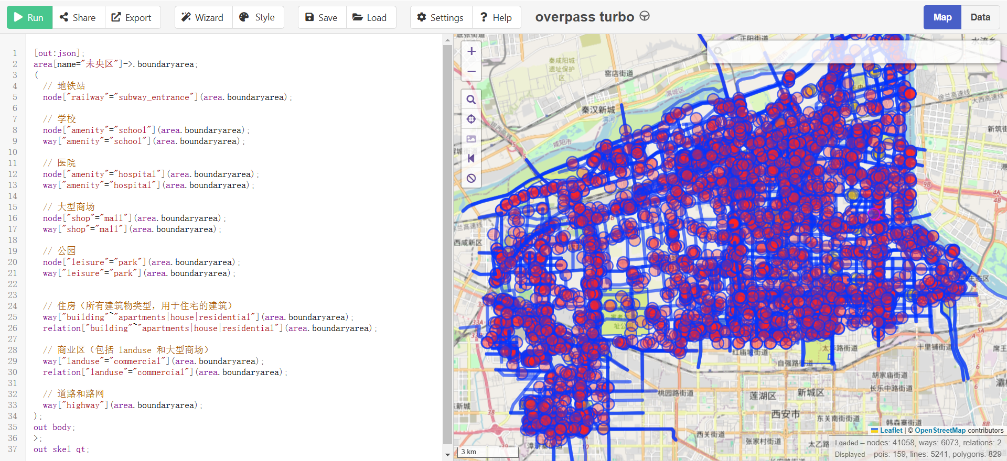
Data collection
Get the geojson file of building information through openstreetmap
https://overpass-turbo.eu/

Slide 5
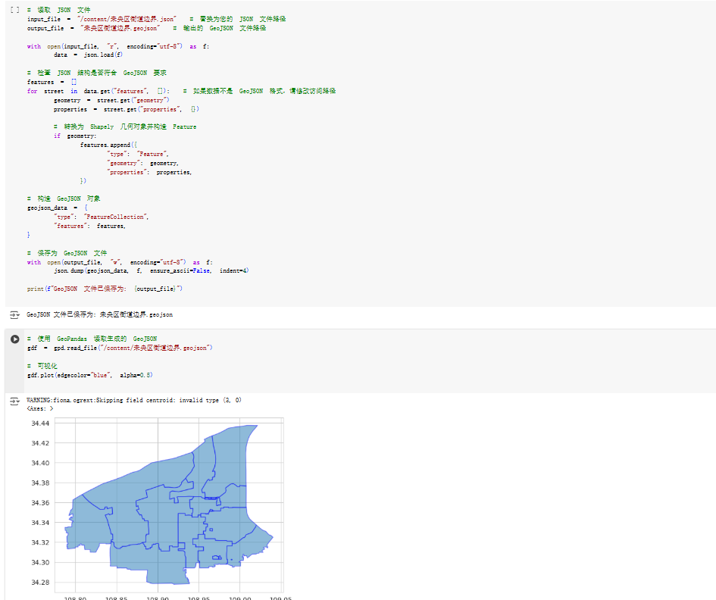
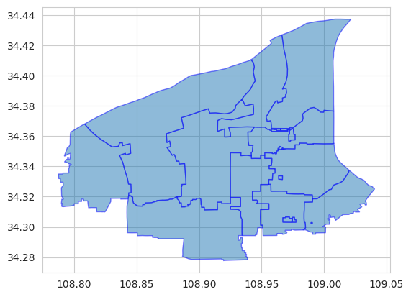
Data collection
Convert the Convert the json file to a geojson file and visualize it.
https://overpass-turbo.eu/

Slide 6
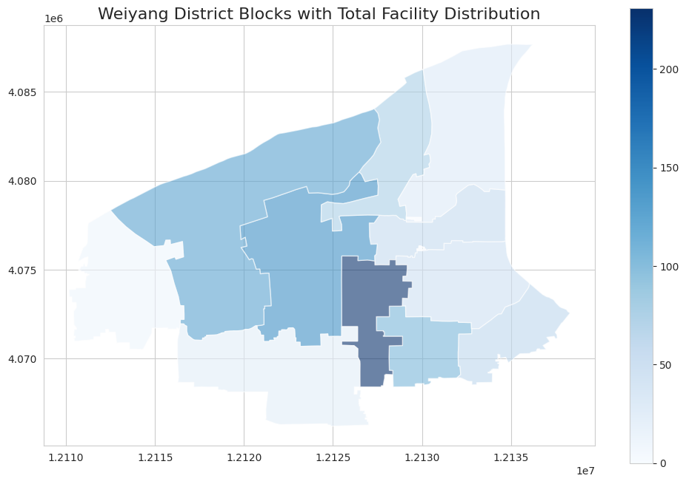
Data collection

Slide 7
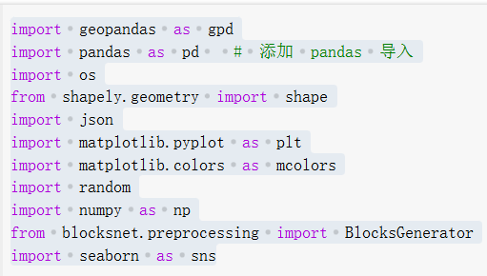
Code library used
Random :Provides random number generation, which is suitable for our situation.
Since I am not proficient in code, I will only introduce an interesting library when using it. I found that the calculation results were different each time, when I use the algorithm,and I was very curious why. Until I found that I needed to use it to stabilize the results.

Slide 8
Evaluation system
Weight distribution, calculation formula, and constraints are performed through government planning documents
Assign weights and allocate weights to different types of facilities based on the location of the block (six directions, north-south plus east-west center, and the 13 blocks are located according to the center of the block):
1. West and northwest: public transportation facilities, bus stations and subway stations, with a weight coefficient of 1.25
2. Central and eastern: schools, hospitals and shopping malls, with a weight of 1.25
3. North: parks, with a weight of 1.25.
4. The weight coefficients of the remaining areas and the remaining types of facilities are all defaulted to 1.

Slide 9
Evaluation system
Because it is a built-up area, the number of buildings that can be added is limited.
Of course, these constraints and weights are just my personal ideas based on urban planning. (We can modify them if necessary)
Constraints:
① Ratio restrictions of other facilities (schools, hospitals, shopping malls, parks):
o The number of facilities of each type in each block can be adjusted by up to ±10%.
o The total number of four types of facilities in the block remains unchanged (different facilities need to be reduced or increased accordingly to balance).
② Public transportation facility restrictions:
o The total number of public transportation facilities in all blocks can be increased by a maximum of 5%, and each block can be reduced by a maximum of 2% and increased by 5%.

Slide 10
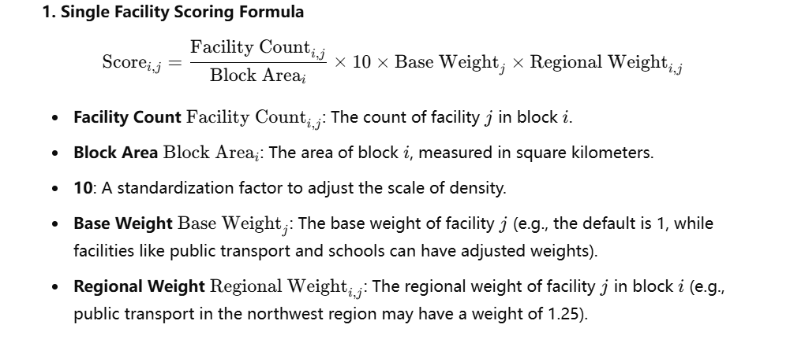
Evaluation system

Slide 11
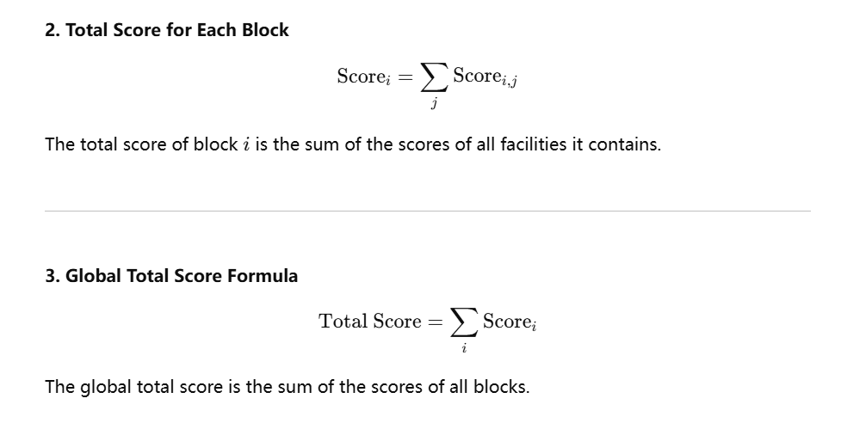
Evaluation system

Slide 12
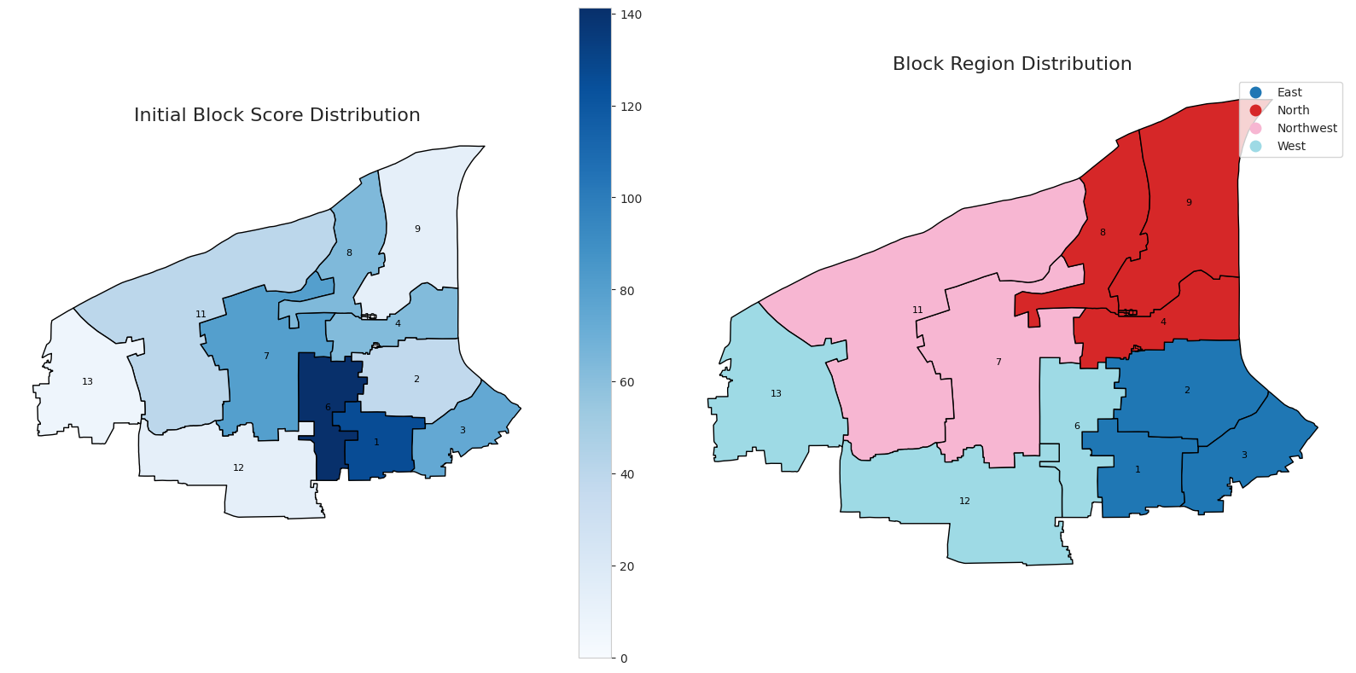
Result analysis
Initial score
The number in the middle of the block is the block ID. It is not difficult to find that the score of the city center is high, while the historical park in the west of the city and the northwest of the city are low.

Slide 13
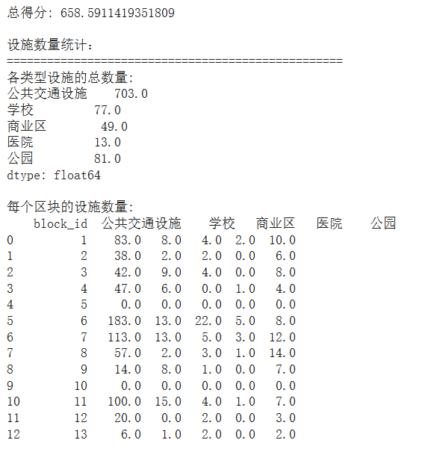
Result analysis
Initial score
Total score
Public transportation
School
Commercial area
Hospital
Park

Slide 14
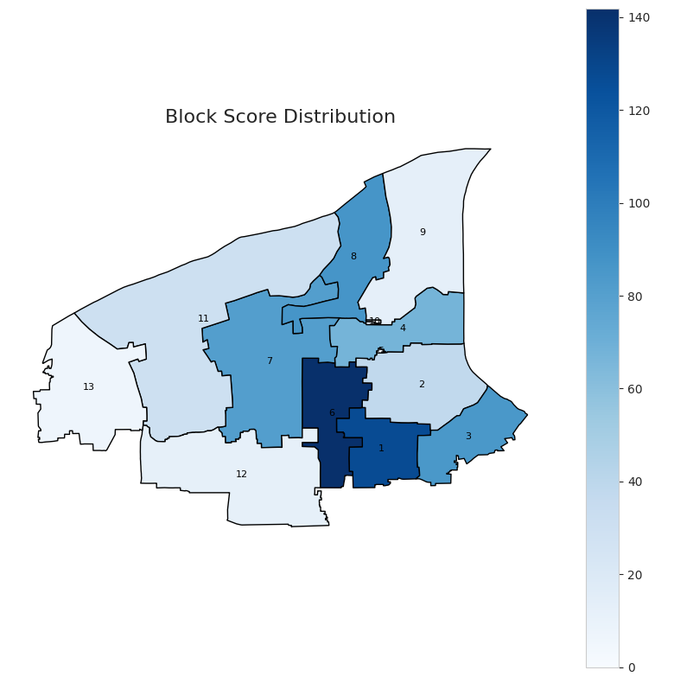
Result analysis
Annealing algorithm
Genetic algorithm

Slide 15
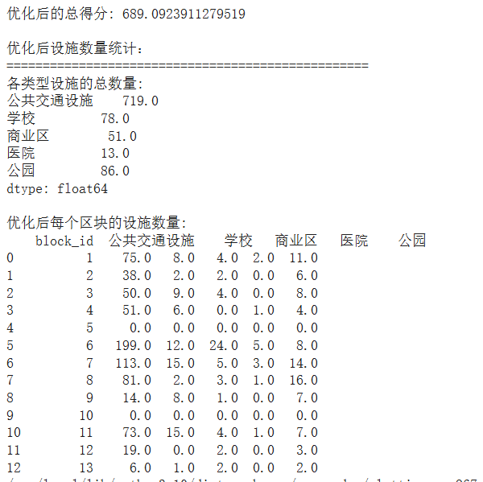
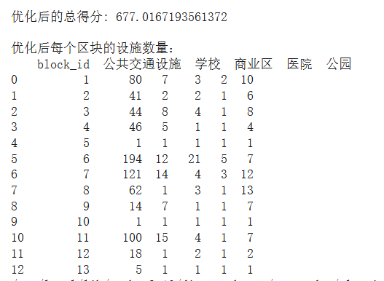
Result analysis
Annealing algorithm
Genetic algorithm
Total score
Public transportation
School
Commercial area
Hospital
Park

Slide 16
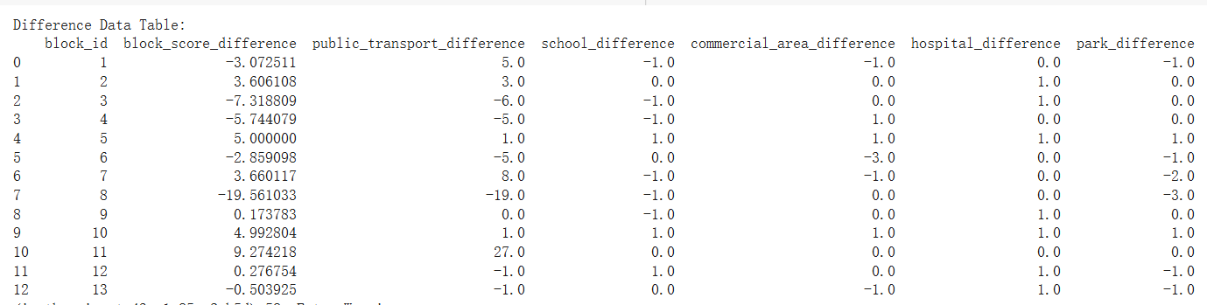
Result analysis
The score of the genetic algorithm minus the score of the annealing algorithm

Slide 17
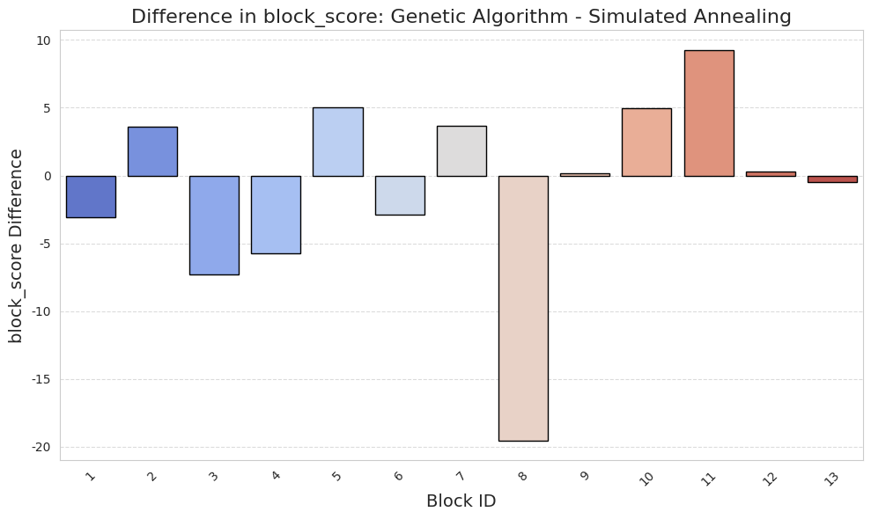
Result analysis
The score of the genetic algorithm minus the score of the annealing algorithm

Slide 18
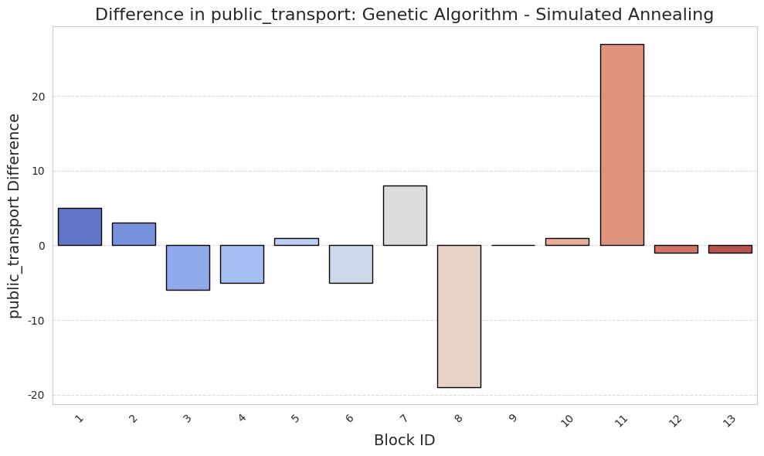
Result analysis
The score of the genetic algorithm minus the score of the annealing algorithm

Slide 19
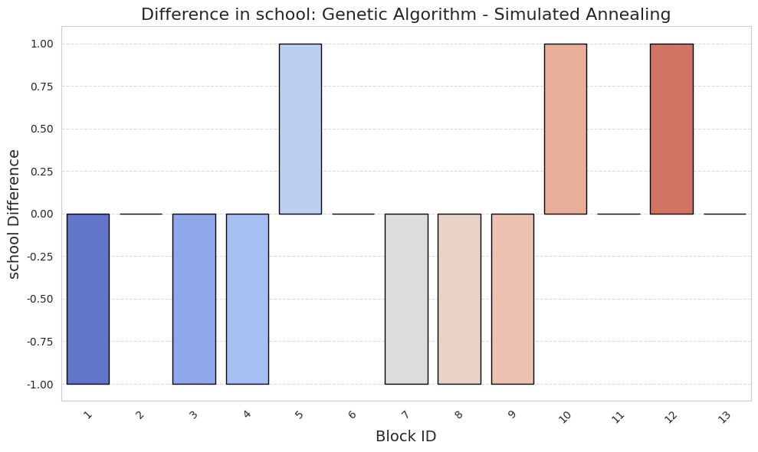
Result analysis
The score of the genetic algorithm minus the score of the annealing algorithm

Slide 20
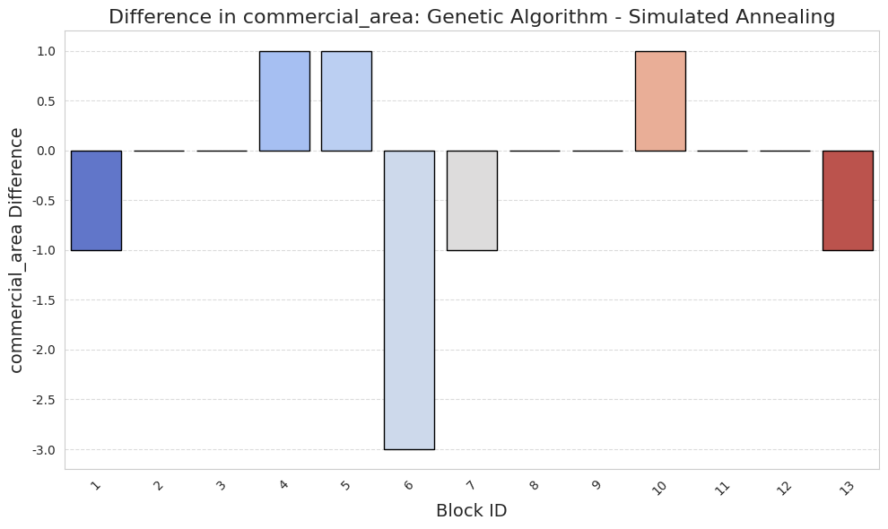
Result analysis
The score of the genetic algorithm minus the score of the annealing algorithm

Slide 21
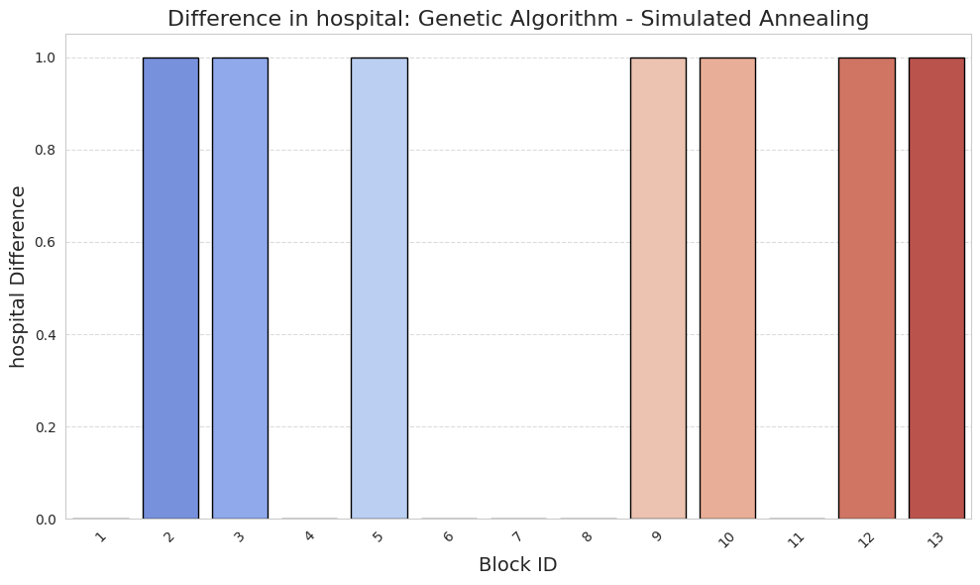
Result analysis
The score of the genetic algorithm minus the score of the annealing algorithm

Slide 22
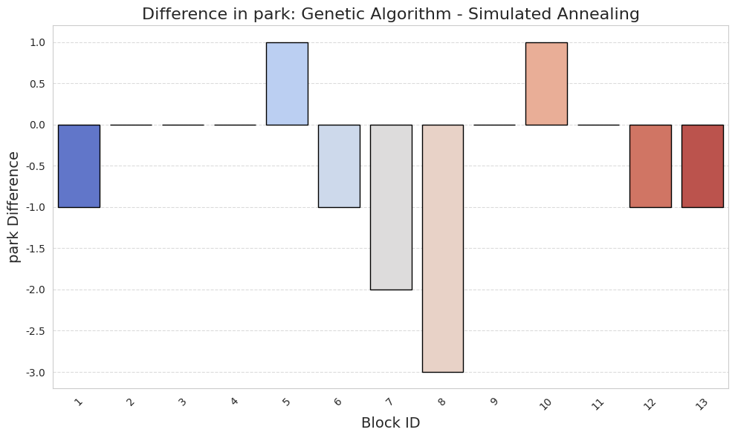
Result analysis
The score of the genetic algorithm minus the score of the annealing algorithm

Slide 23
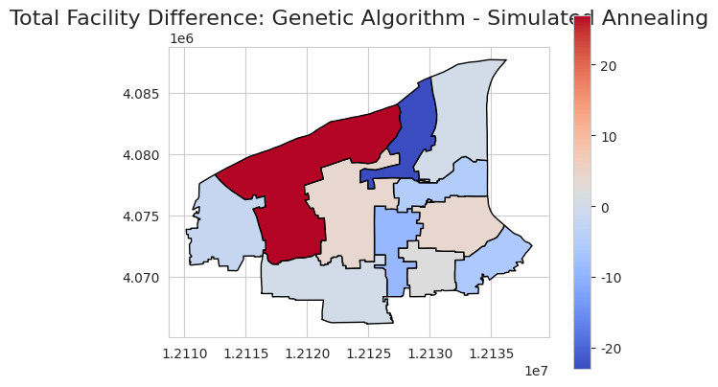
Result analysis
The score of the genetic algorithm minus the score of the annealing algorithm
The genetic algorithm is better in the red block.
The annealing algorithm is better in the blue block.

Slide 24

Conclussions
The total score of the simulated annealing algorithm is higher than that of the genetic algorithm.
This shows that the annealing algorithm is more suitable for the needs of the current data set.

Slide 25

THANK YOU FOR YOUR TIME!

